Slide 1
Dynamic visualization of PLQ functions
URC 2018
Zifang Jiang

Slide 2
Background Information
PL: a real-valued function defined on the real numbers or a segment thereof, whose graph is composed of straight-line sections. It is a piecewise-defined function, each of whose pieces is an affine function
Piecewise linear-quadratic programming problems is crucial in approximating mathematical models
Notes:
The general equation for an affine function in 1D is: y = Ax + c

Slide 3
Why study PWL functions?
Global approximation to study complex functions using PL (easy to plot, manipulate)
1) data representation POV
Describe a complex function
- a finite set of points denoting x, y, s
- a finite set of lines denoting x, s, y* -> conjugates -> a different perspective

Slide 4
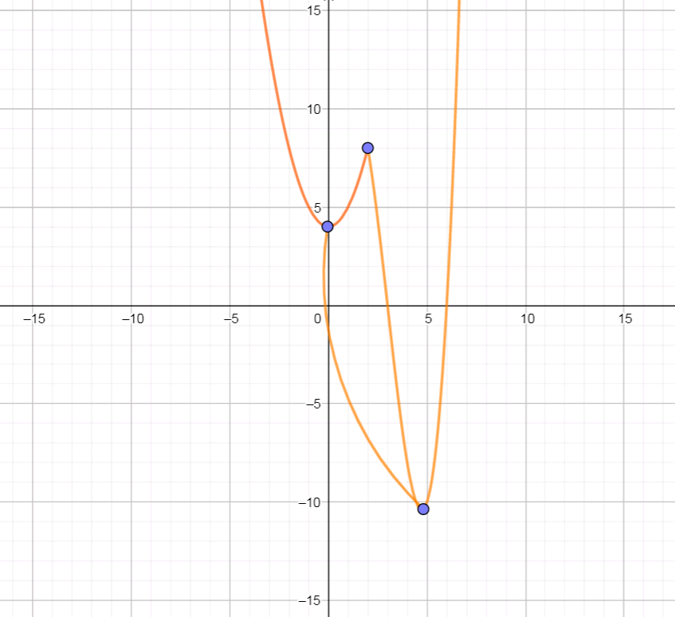
Why study PWL functions?
2) optimization POV find the global minimizer

Slide 5
Why piecewise linear functions?
Linear function is the simplest to plot

Slide 6
Tool to visualize Piecewise Linear function

Slide 7
Piecewise quadratic function
2d
3d

Slide 8
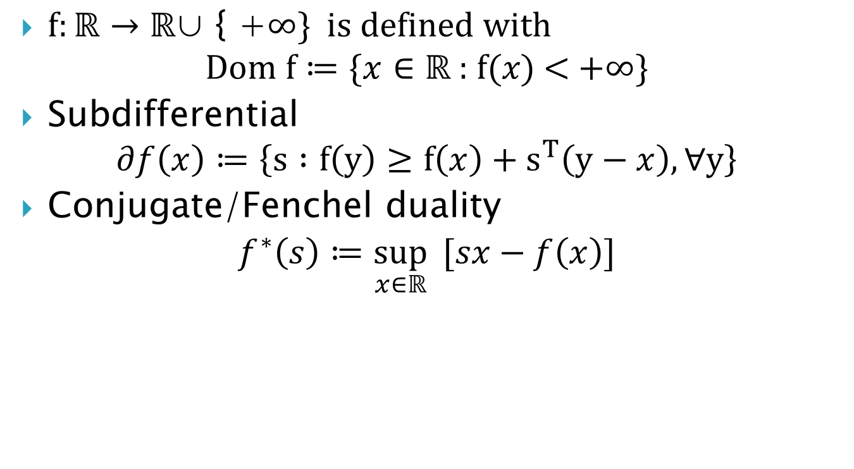
Definitions
$f:ℝ→ℝ\text{∪}\text{ \{ +}∞\text{\} }\text{is} \text{defined} \text{with}$
$$Dom f≔\text{\{}x∈ℝ\text{ : }\text{f}\text{(}x\text{) <} \text{+}∞\text{\}}$$
Subdifferential
$$∂f\left(x\right)≔\left\{s :f\left(y\right)≥f\left(x\right)+s^{T}\left(y−x\right), ∀y\right\}$$
Conjugate/Fenchel duality
$$f^{∗}\left(s\right)≔\sup_{x∈ℝ}{ [sx−f\left(x\right)]}$$
Notes:
$${Dom f}^{∗}\text{ = \{}x∈ℝ\text{ : }∃\text{s} ϵ ∂f\left(x\right)\text{\}}$$
Don’t put this in

Slide 9
Implementation Environment
Geogebra supports javascript
It has a large online development platform and is well-documented as opposed to Cinderella
It supports plotting mathematical equations in 3D as opposed to Unity

Slide 10
Results

Slide 11
2D

Slide 12
3D

Slide 13
Video demo

Slide 14
Future Implementation
PLQ visualization with 8 points

Slide 15
Acknowledgements
Bibliography
CFI
BC Knowledge Fund

